Slide 1
Railway System
Effortless Seat Reservation System
By Eshba CT-25052 , Noman Khursheed CT-25093 Course Code: CT-175 (PF) Section: B Department: CSIT

Slide 2

Introduction
This presentation introduces a simple Railway Reservation System built in C. It helps users book, cancel, and view seat availability for business and economy classes easily. The system offers age-based discounts and provides clear ticket details. Well explore the system features, user interface, technical details, and code explanations with visuals.

Slide 3
01
Railway Reservation System Overview

Slide 4
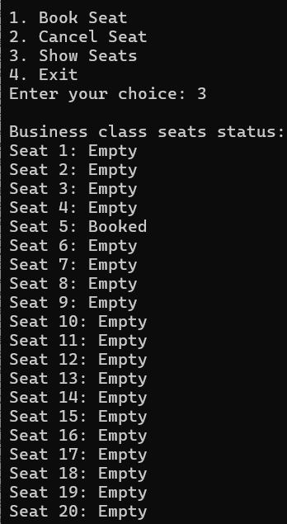
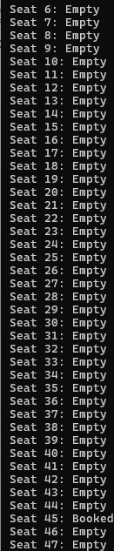
System Purpose and Benefits
Economy seats
Business seats
This system streamlines train seat bookings by managing availability for 20 business and 80 economy seats. It prevents double bookings and speeds up reservation processes. Users benefit from age-based discounts making it fair for children and seniors. Overall, it improves booking convenience and accuracy.

Slide 5
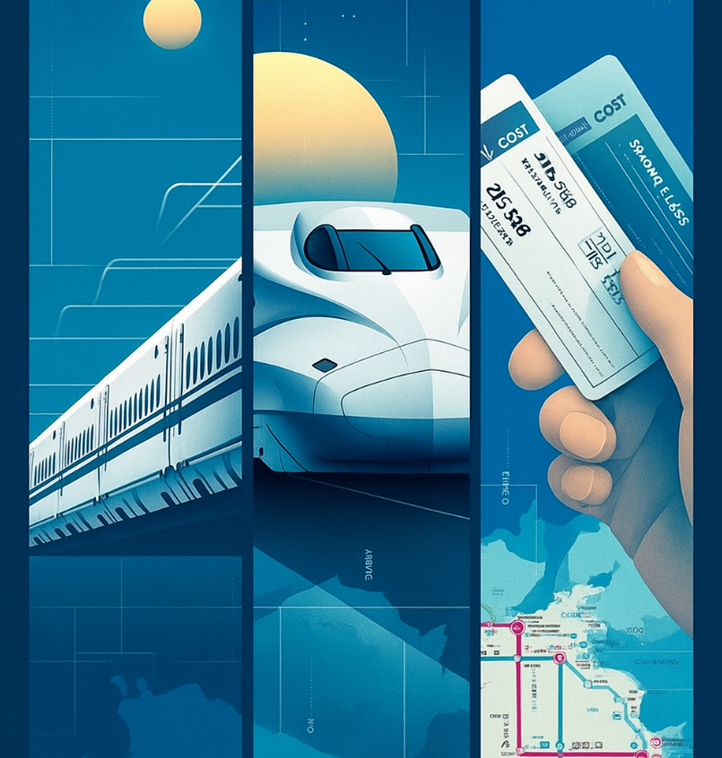
Core Features and Functionalities
Users can book seats with name and age, cancel reservations, and check seat status. The menu interface is intuitive and error resistant. Pricing varies by class—Business seats cost more. Discounts apply automatically, and users receive a detailed ticket summary confirming their reservation.

Slide 6

User Interaction and Interface Design
The console interface presents a clear menu for booking, cancellation, and checking seats. Users input details step-by-step, with prompts that catch invalid inputs and guide corrections. This ensures easy navigation and reduces confusion during booking or cancellation actions.

Slide 7
02
Technical Implementation and Code Explanation

Slide 8
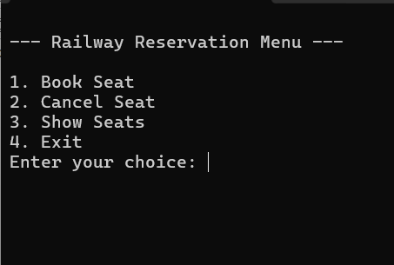
Console Interface and Menu Design
The program features a simple console menu with clear options: Book Seat, Cancel Seat, Show Seats, and Exit. Input prompts guide users step-by-step, with validation to prevent mistakes. This straightforward design ensures accessibility for all users, keeping interactions friendly and intuitive.

Slide 9
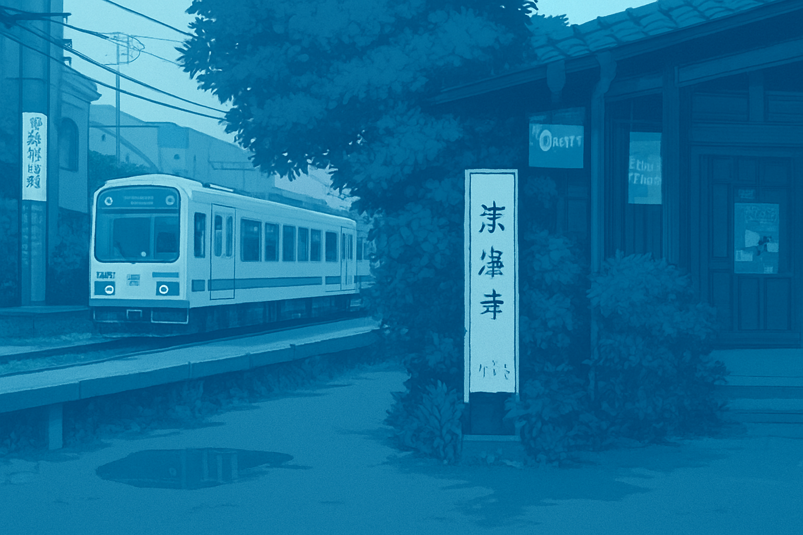
System Architecture and Components
The program uses two arrays to track business and economy seats’ booking status. A loop controls the menu flow, handling user choices and managing seat assignment. Input validation and discount calculations are integrated. The structure ensures efficient seat management and smooth user experience.

Slide 10

Key Code Snippets and Their Functions
Critical code manages seat validation, booking logic, and cancellation by checking and updating array values. Pricing logic applies discounts for age groups under 12 and over 60. Input parsing ensures only valid data is accepted. The system prints a formatted ticket receipt with all booking details.

Slide 11
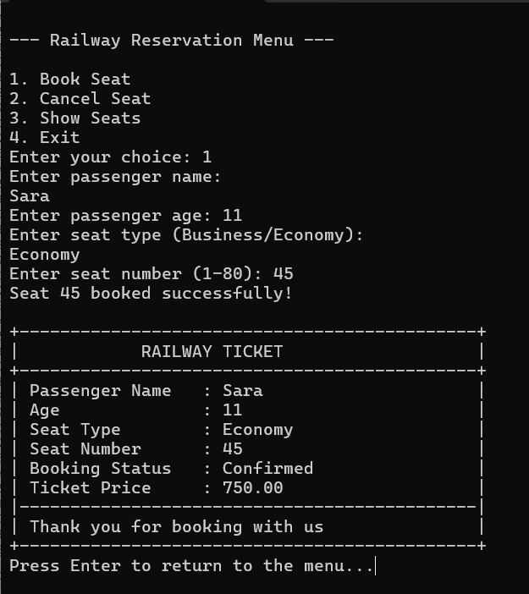
Visualizing Code Flow
Visual aids illustrate the main menu loop, user input steps, and how seat status is updated. Screenshots of console outputs showcase booking confirmation and seat status views.

Slide 12
03
Booking and Cancellation Processes
Booking requires selecting seat type and number; system confirms availability before confirming the booking. Cancellation asks for seat number and checks if booked before allowing cancellation. Both processes include error handling to avoid invalid operations

Slide 13
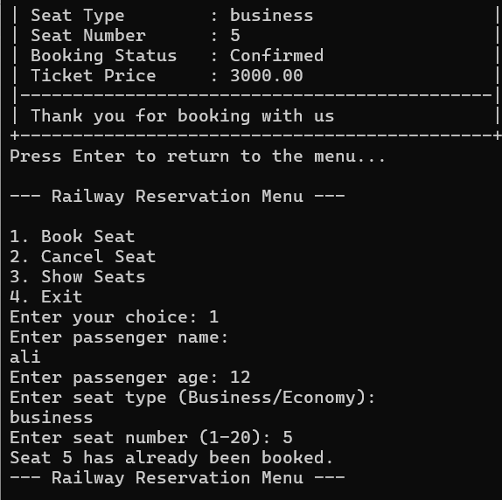
Booking Logic and Seat Validation
Booking involves choosing seat type (business or economy), entering seat number, and verifying availability through array checks. If the seat is free, it is marked as booked. Age-based discounts apply, reducing ticket price for children and seniors. Error checks ensure valid seat numbers and types before confirming the booking.

Slide 14
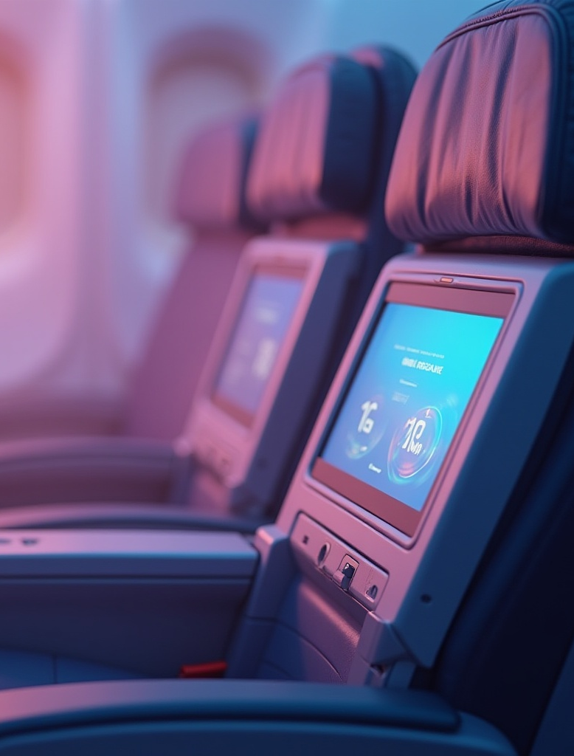
Cancellation Procedure and Error Handling
Cancellation requires the user to input the seat number to cancel. The program verifies if the seat was previously booked and updates the status accordingly. If the seat wasnt booked or the input is invalid, appropriate messages are shown to guide the user, ensuring smooth cancellation handling without system errors.

Slide 15
Ticket Summary and Confirmation Display
Once a booking is successful, a formatted ticket summary prints passenger details: name, age, seat type, seat number, status, and final price including discounts. This confirmation reassures users that their reservation is complete and provides a clear reference for their booking.

Slide 16
04
User Experience and Enhancements

Slide 17
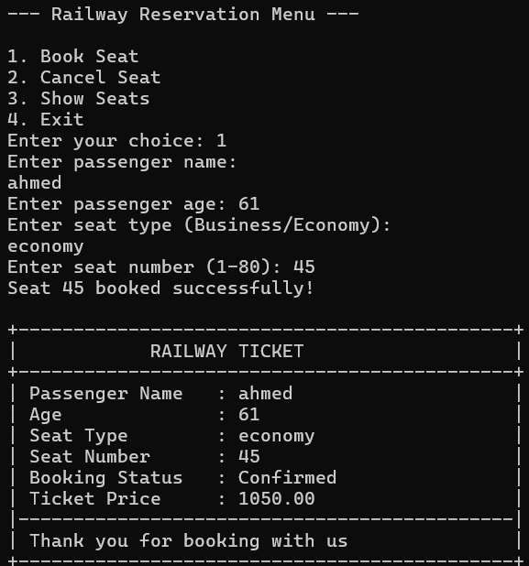
Age-Based Pricing
The system applies discounts automatically: children under 12 pay half price, while seniors 60 and over receive a 30% discount. This age-based pricing promotes fairness and affordability while keeping the pricing logic clear and manageable within the code.

Slide 18

Conclusions
This Railway Reservation System combines simplicity with essential features, offering easy booking, cancellation, and seat management. Its friendly console interface and solid code structure ensure a smooth user experience. Incorporating age-based discounts makes travel more accessible, providing a strong foundation for future enhancements and broader applications.

Slide 19
THANKS!
n

